Slide 1

Web Filtering

Slide 2


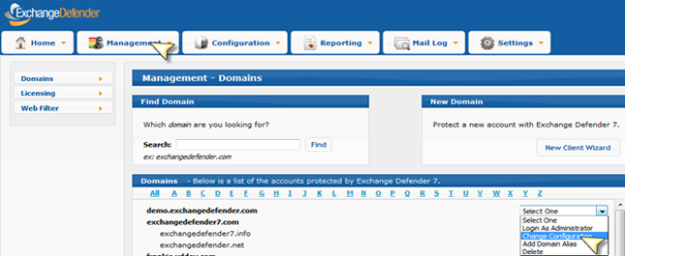
Introduction
ExchangeDefender Web Filtering provides policy-controlled protection from dangerous content on the web. Web Filtering is agent based, allowing you to protect your users on the local network as well as on the go, across all web browsers. For administrative convenience there are over 80 categories of sites that you can selectively block access to and receive reports when your users violate the corporate policy.
Partners can configure and manage the web filtering feature policy restrictions through their ExchangeDefender Service Provider Admin portal.
Configure Web Filtering Settings
You can configure your web filtering settings in many ways. You can set them as the Service Provider which will automatically apply the policies to all domains and users. You can also set the policies on a domain level basis, or on a per user basis.
1. Login to your Service Provider account in the ExchangeDefender Admin Portal or the domain administrator account with the correct email address and a password.
2. Click the Management tab on the top navigation bar and click on Domains. From here you can choose the specific domain that you wish to set web filtering policies for.

Slide 3
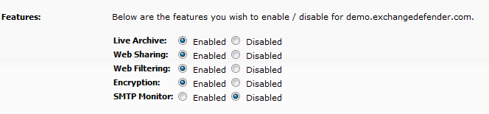
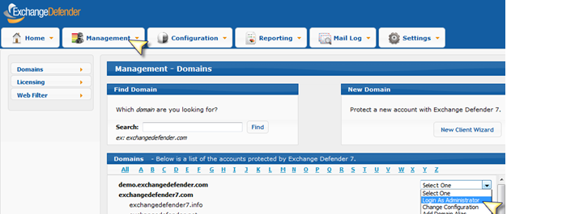
3. Next be sure to enable Web Filtering on the domains you wish to set policies for. In order to do this you must be logged in as the administrator and click on Change Configuration for that domain.
4. Once logged into the Configuration settings for a specific domain scroll down to the bottom of the configuration settings to the Features section. Be sure that the Web Filtering feature is enabled and then click on Change Settings.
5. Once the Web Filtering feature is enabled you can begin to set policies on the domain level. Next select Login as Administrator in the action selection box.

Slide 4
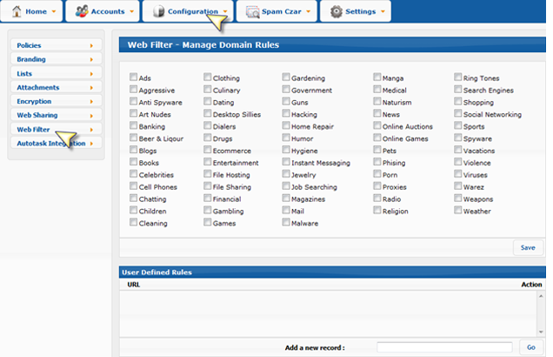
6.Click the Configuration tab and select Web Filtering.
7. You will then see the list of Domain rules to set your domain level policies. Check on the categories that you wish to be blocked for all the users in that specific domain and save your changes.
8. In the User Defined Rules section at the bottom you can set specific domains to be blocked on a domain level basis. After adding new records click Go and then click Save.
*Note: When adding new records to the user defined rules list do not type the www. before a web address. For example instead of www.facebook.com just type facebook.com.

Slide 5
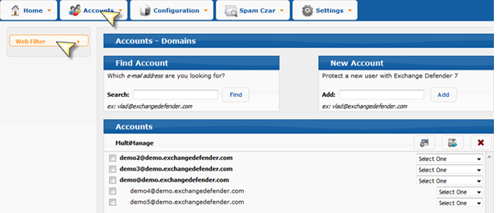
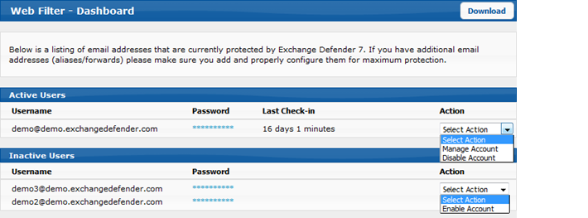
9.Next to set policies on the individual user level hover over the Accounts tab and click on Web Filter.
10. You will then go under the Inactive Users section and click on the Action drop down to enable account. This will move a user in the domain to the Active User lists and it will apply all of the domain level policies to that user. This is how the screen will appear after you move a user to be active.
11. To set individual policies click on the Action drop down and select Manage Account.
12. Here you will see the list of categories in which you can choose from as well as the user's username and password.

Slide 6
13. Here you can choose categories to block from the specific user and also set defined rules at the bottom. Again, when finished click Save. (Note: The domain level categories will automatically be blocked but will not show up as a checked category on the individual user level.)
14. Once you have set policies for the domain and on all the desired individual users you will then download the Web Filter Agent on each of the user's workstations.

Slide 7
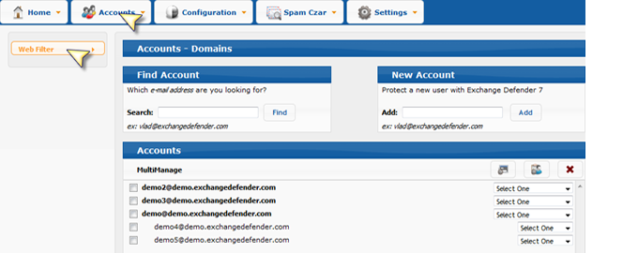
Installing the Internet Web Filter
1.In the Domain administrator's log in hover over the Accounts tab and click on Web Filter.
2.In the upper right corner of this page you will see an Internet Web Filter section with a download link.

Slide 8
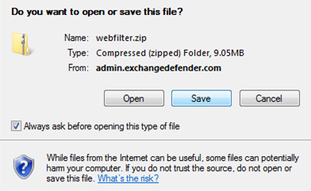
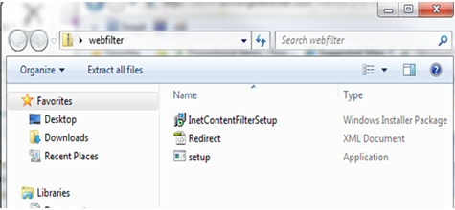
3.Click on the download link and Save the file to your desktop.
4.When the file is done downloading, open it. It will be a .zip file with 3 files attached.
5.Next extract all 3 files to your desktop.

Slide 9
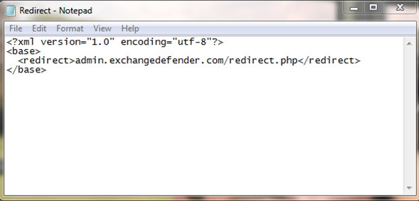

6.Before you begin the installation process open the XML Redirect file.
7. Here you can change the location of the landing page when a website is accessed when it is blocked. For Example, you could change it to google.com or your company website. Save and close the Redirect file.
8.Next click on the Setup file.
9.The installer will then prompt you to click next a few times and then will install the Internet Web Filter. After the download is complete, WinPcap will prompt you to click Next and Agree and then Install. Once the install is complete click Finish.

Slide 10
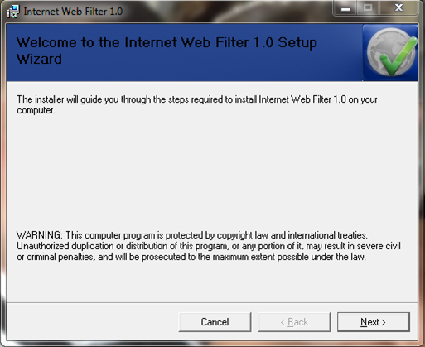
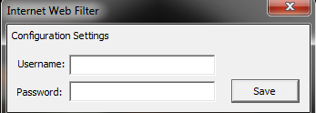
9.The installer will then prompt you to click next a few times and then will install the Internet Web Filter. After the download is complete, WinPcap will prompt you to click Next and Agree and then Install. Once the install is complete click Finish.
10.Next, the Configuration settings box will pop up. Use the same credentials as you do in ExchangeDefender. The username and password are specific to each individual user. Once you click save your settings will be updated and ready to start filtering on that workstation.

Slide 11
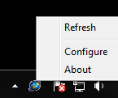
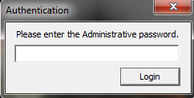
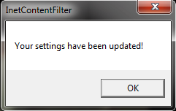
11. The Internet Web Filtering icon sits at the bottom of your screen in the System Notification Area. If you need to change the user for the web filtering device because of shared computer usage you will then right click on the Configure option.
12. Here you will be prompted for the Administrative password. This is a password that only the service provider should have access to because it has the ability to change users and apply their individual level policies on the web filter. The password is "shockmonkey".
13. Once the password is accepted you can then re-login to another user-s policy settings by using the user's log-in credentials.
14. The Internet Web Filtering icon sits at the bottom of your screen in the System Notification Area. If you need to change the user for the web filtering device because of shared computer usage you will then right click on the Configure option.

Slide 12
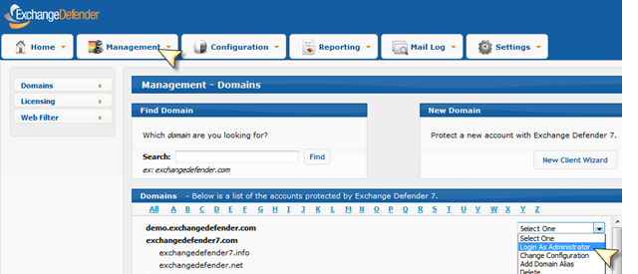
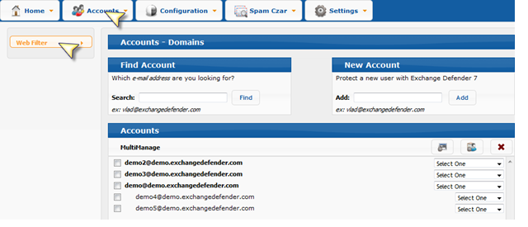
View the Reporting Options
With Web Filtering you can view a report of each individual user's web activity. Here you can see 2 graphs that show the number of categories blocked and how many times a user attempted to look at different websites. There is also an access log that tells the administrator which domains a user attempted to access and also adds the timestamp.
1.In order to access the reports for each user, you should log in as the Administrator for a specific domain.
2.Next, hover over the Accounts tab and click on Web Filtering.

Slide 13
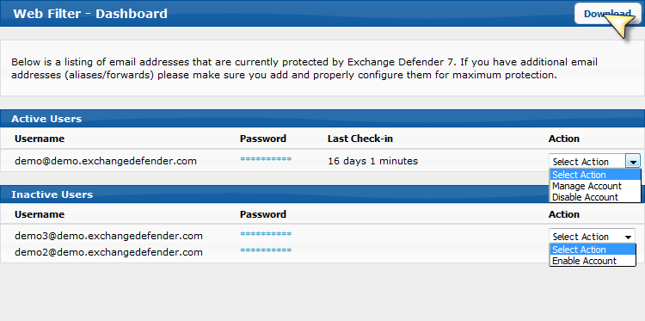
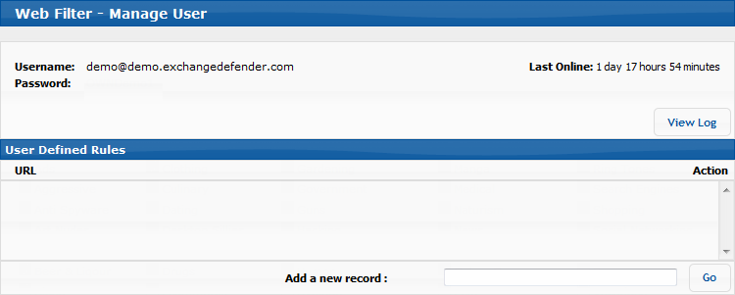
3.Here you should choose the user you wish to view the report of. In the Actions drop down select Manage Account.
4.Then you click on the Log icon in the upper right hand corner.

Slide 14
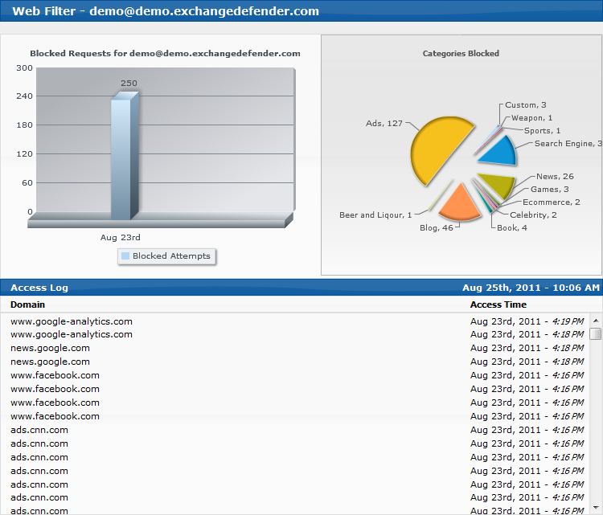
5.The user's Web Filter report will then appear.
If you have further questions about the capabilities or uses of Web Filtering please refer to the ExchangeDefender Web Filtering Feature site.
Congratulations, you have successfully configured ExchangeDefender Internet Web Filtering! You should now perform a full backup and restart your computer for all of the changes to fully take effect.

