Slide 1
Web File Sharing

Slide 2
Introduction
Web File Sharing from ExchangeDefender will allow clients to securely share files using their ExchangeDefender login. Partners can configure and manage the quotas and file restrictions through their ExchangeDefender Service Provider Portal.
This guide will take you step by step on how to properly set up and use the Web File Sharing feature of ExchangeDefender.
Configure Web File Sharing Settings
1. Please login to your Service Provider account in the (ExchangeDefender Admin Portal) with your email address and password.
2. Click Management on the top navigation bar.
3. Select Login as Administrator in the action selection box.

Slide 3
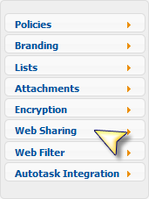
4. Hover your cursor over the Configuration tab and select Web Sharing.
5. From the main page you can easily add and manage extensions to allow or block from user uploads.
6. Underneath the file extensions you can manage the file quotas and total storage size. After adjusting the quotas click Update to apply the changes.

Slide 4
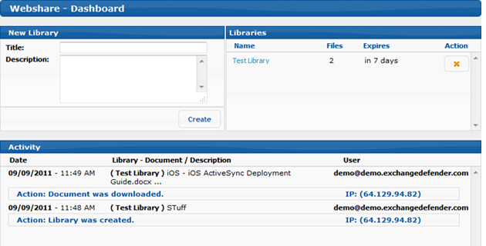
Upload Documents and Manage Libraries
1. Log into the(Web File Sharing Portal) with your ExchangeDefender quarantine credentials.
2. After logging in, you will be presented with the Web share Dashboard which will show a quick glance at your Library list, account activity, and the ability to create new libraries.

Slide 5
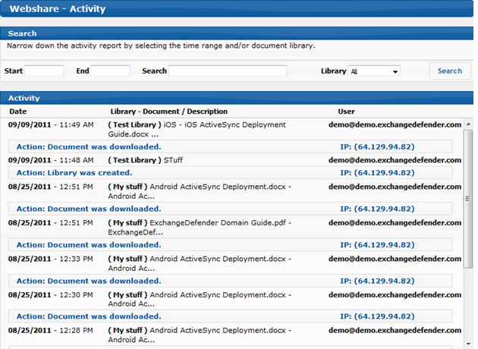
3. Under details you can view detailed information about Library modifications, file downloads and uploads.

Slide 6
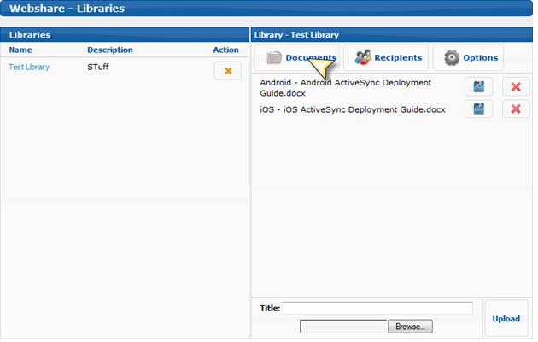
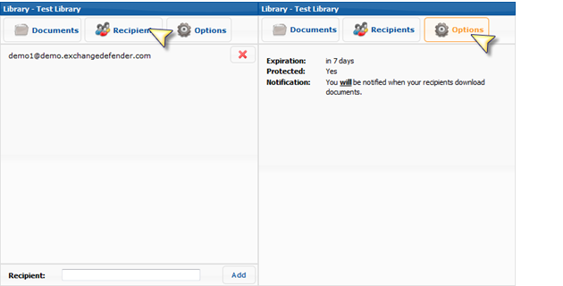
4. Under the Libraries listing you can select a library to view the details.

Slide 7
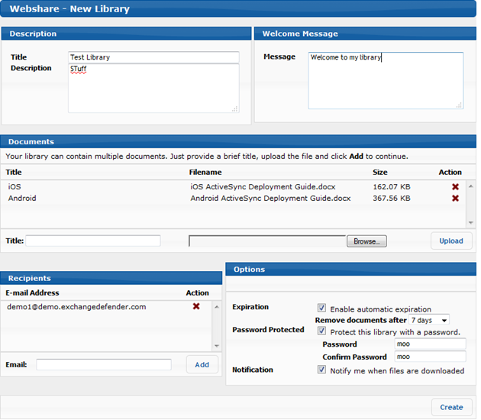
Creating a New Library
1. In the Web File Sharing Dashboard you can easily create Document Libraries by providing the Library Title and Description. After filling in the required information, click Create.
2. After providing the Library title and Description, you can optionally notify the individuals about the available document library.
3. Next, you'll provide the document(s) title and then select browse to select the file(s).
4. Optionally, users can set expiration dates for the library, set a library password and elect to be notified when files are downloaded.
5. Any individuals added to the recipient list will receive two emails, one containing the library link and one containing the library password.

