Slide 1

SPAM Settings

Slide 2


Overview
The ExchangeDefender Admin Site is a powerful tool that gives you access to all of the benefits ExchangeDefender has to offer, from the safety and convenience of your web browser. This guide will familiarize you with our web site and offer helpful tips on how to manage your ExchangeDefender service to get the most out of your Inbox experience.
ExchangeDefender is a cloud-based productivity suite that delivers security, business continuity, regulatory compliance and business information management tools. ExchangeDefender technology provides the following benefits: SPAM filtering, virus filtering, malware protection, DDoS protection, business continuity, Outlook integration, email SPAM quarantine reports, transparent and regulatory encryption, web filtering, desktop alerts, SMTP service monitoring and managed services, Exchange 2010 archive access, long term compliance archiving, HTML5 mobile application and so much more. The wide range of solutions in our portfolio is tightly integrated to give users a seamless experience, access different tasks, and be flexible enough for the unique way in which each company implements ExchangeDefender.
ExchangeDefender guides are intended to introduce basic service concepts and offer productivity tips that our customers have previously shared with us. If you have any suggestions or questions please don't hesitate to contact us.
ExchangeDefender Admin Web Site
To manage your ExchangeDefender service simply open a browser and point it to:
https://admin.exchangedefender.com
This secure website is protected using the same level of encryption that your bank, credit card, and ecommerce sites rely on.

Slide 3
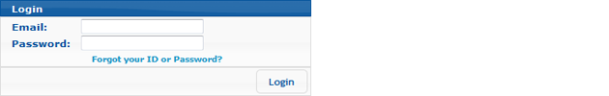
Logging In
Your ExchangeDefender login credentials should have been emailed to you by your IT Solution Provider when your organization was protected by ExchangeDefender. Simply type in your email address and your password to login.
If you encounter issues with your login credentials you can always request to have them emailed to you.
Password Reminders
To request a login credentials reminder please click on Forgot your ID or Password? Link at https://admin.exchangedefender.com.
Provide your email address and the system will email you login credentials to access the site.
If your email address is not protected by ExchangeDefender you will have to contact your IT Solution Provider for further assistance. For security reasons, passwords cannot be emailed to a different address or reset without access to your mailbox.
Dashboard Overview
ExchangeDefender dashboard is the home screen for all ExchangeDefender applications. Based on the AJAX technology, the web site responds and behaves more like a desktop application and provides smooth transitions and faster load times.

Slide 4
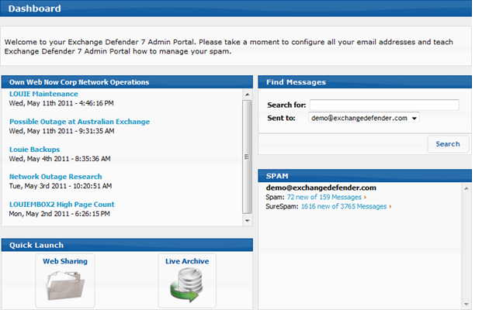
Across the top of the site you will see the navigation menu, You can access all the sections of the ExchangeDefender service from here. On the left, you will see context navigation menus that will lead you to more advanced settings depending on what you are currently doing. Finally, the main section of the page takes up the majority of the web site and presents the most relevant data.
Dashboard page will offer your network operations alerts, quick launch links to other ExchangeDefender applications, Find Messages section fro quick SPAM searches as well as your SPAM quarantine reports which reflect real-time SPAM contents of all your protected email address.

Slide 5
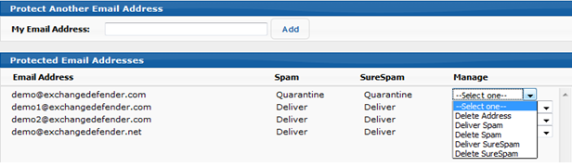
Reviewing SPAM
ExchangeDefender SPAM quarantine to access messages that were identified by our content filtering as SPAM. You can quickly locate a specific message by using the Find Messages search function or you can browse the SPAM quarantines by clicking on the appropriate email address.
What is the difference between SPAM and SureSPAM?
ExchangeDefender uses automated text and pattern to determine if there are many likely SPAM patterns in each message you receive. If we are fairly confident (80%) that the message is SPAM (99%) we will store it in the SureSPAM quarantine.
If you choose to Deliver or Delete your SPAM or SureSPAM messages you will not see the SPAM quarantines because no SPAM would be stored by our system. To browse the messages simply clock on SPAM or SureSPAM quarantine you wish to review.
Managing Protected Email Addresses
ExchangeDefender allows you to protect multiple email address that belong to you or that you are in charge of by clicking on "Email Address". For example, many organizations have Public Folders or different role accounts (info, sales, etc.) that are the responsibility of an individual employee. You can assign all of your email addresses to your account so that you can centrally manage them all.
Each email address protected by ExchangeDefender allows you to customize it's SPAM management policy. SPAM and SureSPAM messages are separated in different queues and ExchangeDefender can delete, quarantine, or simply tag and deliver messages going to your Inbox.
Note: Changes that are made here are not retroactive. For example, if you had ExchangeDefender configured to delete SPAM and decided to make it quarantine messages instead, you will not be able to view or release messages that were previously categorized as SPAM and thus already deleted.

