Slide 1

Offsite Backups

Slide 2


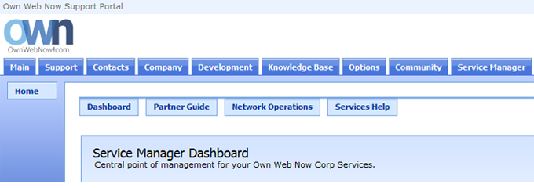
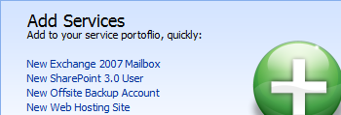
Introduction
The purpose of this Startup Guide is to familiarize you with Own Web Now's Offsite Backup offering and show you how to purchase, deploy and manage the service. Offsite Backup offering is an agent-based solution powered by AhSay's Offsite Backup Manager (OBM) for secure, encrypted and flexible file backup and retention. While this guide only covers the deployment of our most popular Windows platform, Offsite Backup agents are available for backup of all Windows 32bit and 64bit platforms, Apple Mac OS X, Linux, Novell, Solaris and virtually any platform that Java runs on. Also keep in mind that our Offsite Backup solution includes free backup agents for SQL, MySQL, Shadow Copy, Exchange, Oracle and a number of other services but choosing how to structure your backup policies is beyond the scope of this guide.
Ordering Offsite Backups
1. Please login to the Own Web Now Support Portal (https://support.ownwebnow.com) with your email address and a password.
2. Click on the Service Manager tab. This will bring up the Service Manager Dashboard from which you can order and manage all your offsite backup services.
3. You can quickly subscribe to all of our services on the right in the Add Services section. Click on New Offsite Backup Account to proceed.

Slide 3
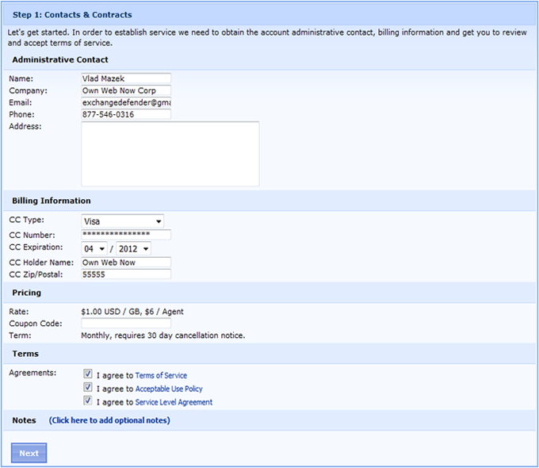
4. Please provide the Contact and Billing information for this order. You will be asked to confirm your billing data, address and the usual contract terms of service agreements.

Slide 4
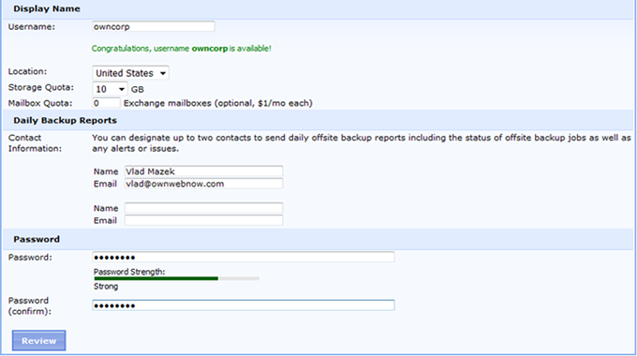
5. After clicking Next you will be presented with the configuration section. You will be prompted for the username you wish to use to authenticate to the offsite backup, location in which you wish to have your files stored, the storage quota and the contact person for the account so we can send them offsite backup reports.
Please note that the location of Offsite Backup data is not highly relevant because all data is encrypted and compressed on your workstation or server before being sent to us. You do have a choice to which network you wish to backup your data.
Storage quota refers to the amount of raw space you will be using on our systems. You can change this storage quota at any time as you grow or reduce the amount of data you are backing up. Because data is compressed before it is uploaded to our servers, you will get far more space in the quota than you are actually backing up. However, as your retention grows and you keep multiple changes of each file you may need to increase your quota.
Mailbox quota refers to the number of Exchange brick-level mailboxes you wish to back up. While the whole store (entire mail database) backup for Microsoft Exchange is free and included with your monthly fee, you can optionally add Mailboxes to be backed up at "brick level" allowing you to restore individual mailboxes, folders and mail items. The cost of mailbox "brick level" backups is $1 per mailbox per month.
Daily Backup Reports allow you to automatically send successful and failed backup reports via email. You can add up to two email addresses. If you need to distribute the report to multiple contacts you may consider creating a distribution list on your own server and pointing it to that.

Slide 5
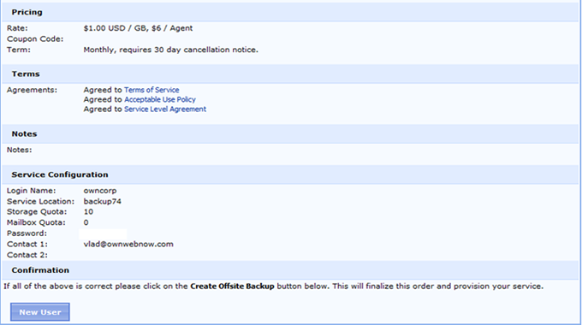
6. Click on the Review button to proceed. A brief summary of the order and configuration will be presented to you.
Please take a moment to review your login name, backup server, storage quota and the mailbox quota. This information will also be emailed to you as soon as the service is set up, generally within 60 seconds.

Slide 6
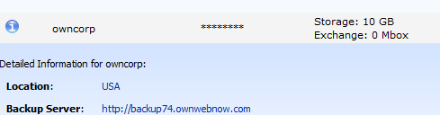

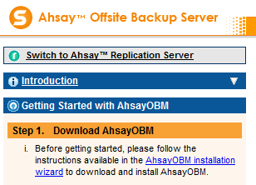
Introduction
ExchangeDefender's Offsite Backup is powered by AhSay Offsite Backup Manager (OBM) and you can always download the latest version from our backup servers. Any time you wish to make any kind of management change to your offsite backup service, from changing the quota to changing the password or downloading the agent, you should login to OWN Support Portal and click on the Service Manager tab (https://support.ownwebnow.com).
Click on the Offsite Backup icon and you will be presented with a list of your backups. On the right will be available actions such as changing the password or modifying the account. On the left is a blue icon next to the username. Click on the icon and a Detailed Information screen will drop down. Note the Backup Server address.
1. Navigate to the Offsite Backup server provided (in this example it's http://backup74.ownwebnow.com). Click on Getting started with AhsayOBM and then select AhsayOBM Installation Wizard.

Slide 7

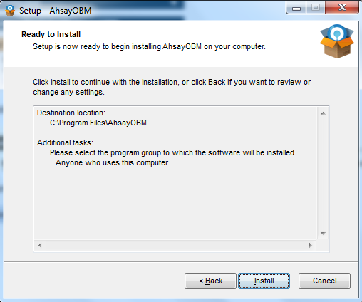
2. Click on the AhsayOBM installation wizard to download Ahsay Online Backup Manager.
3. Once the download is complete, execute the installer and follow the options.
Note: The installation and deployment process is different for each platform, this guide only covers the Microsoft Windows version of AhSay OBM. There are also agents for Mac OS X, Linux, Solaris, Novell and more.

Slide 8
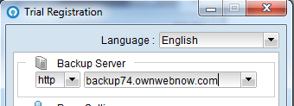
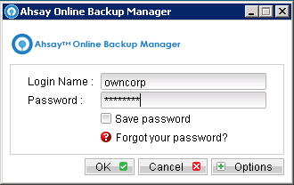
Configuration
Your Offsite Backup service is managed through the AhSay Offsite Backup Manager (OBM) which is installed on the server or workstation that you wish to back up. Backing up and restoring data is very easy but you will need some information from the Service Manager tab (see previous step on how to retrieve the server information and login credentials.
1. On the server or workstation you wish to back up or restore files on, start the Offsite Backup Manager.
2. Provide the Backup Server address that the account is on. This information has been emailed to you and is available on the Service Managertab in our OWN Support Portal (https://support.ownwebnow.com).
3. Type in the Offsite Backup username and password you selected when signing up for the Offsite Backup service.

Slide 9
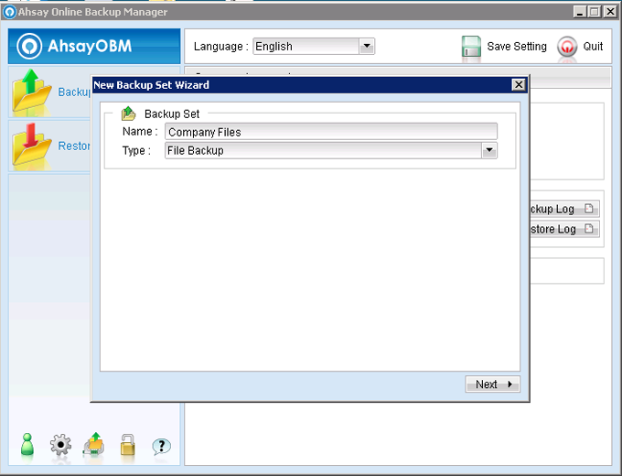
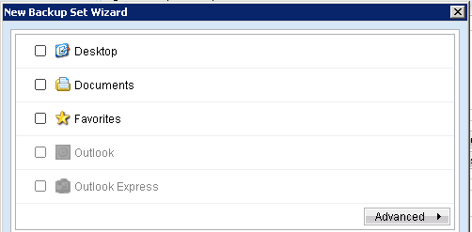
4. The first time you start AhSay OBM you will be presented with the New Backup Set Wizard. Pick a name for the backup set and the backup type (File backup, SQL backup, Exchange Information Store, etc).
5. Unselect Documents and click Advanced to select files and folders you wish to backup.

Slide 10
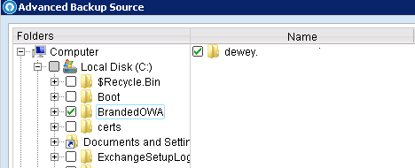
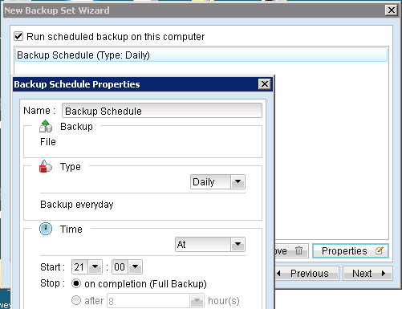
6. Select the files and folders you wish to include with this backup set.
7. Select the default backup schedule and click on Properties to set the backup type, time and frequency.

Slide 11
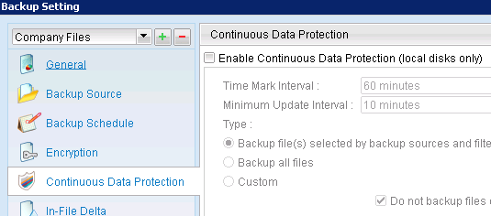
8. Once you are satisfied with the encryption type and backup time click on Finish.
9.To change advanced options (Such as Continuous Data Protection) for the backup set click on the gear icon.
10. Once you have finalized your Backup Settings click on the green icon to add the backup set.
Congratulations, you have configured Own Web Now's Offsite Backup service and created a new backup set!

