Slide 1
Whitelist Management

Slide 2
Overview
The ExchangeDefender Admin Site is a powerful tool that gives you access to all of the benefits ExchangeDefender has to offer, from the safety and convenience of your web browser. This guide will familiarize you with our web site and offer helpful tips on how to manage your ExchangeDefender service to get the most out of your Inbox experience.
ExchangeDefender is a cloud-based productivity suite that delivers security, business continuity, regulatory compliance and business information management tools. ExchangeDefender technology provides the following benefits: SPAM filtering, virus filtering, malware protection, DDoS protection, business continuity, Outlook integration, email SPAM quarantine reports, transparent and regulatory encryption, web filtering, desktop alerts, SMTP service monitoring and managed services, Exchange 2010 archive access, long term compliance archiving, HTML5 mobile application and so much more. The wide range of solutions in our portfolio is tightly integrated to give users a seamless experience, access different tasks, and be flexible enough for the unique way in which each company implements ExchangeDefender.
ExchangeDefender guides are intended to introduce basic service concepts and offer productivity tips that our customers have previously shared with us. If you have any suggestions or questions please don't hesitate to contact us.
ExchangeDefender Admin Web Site
To manage your ExchangeDefender service simply open a browser and point it to:
https://admin.exchangedefender.com
This secure website is protected using the same level of encryption that your bank, credit card, and ecommerce sites rely on.

Slide 3
Logging In
Your ExchangeDefender login credentials should have been emailed to you by your IT Solution Provider when your organization was protected by ExchangeDefender. Simply type iin your email address and your password to login.
If you encounter issues with your login credentials you can always request to have them emailed to you.
Password Reminders
To request a login credential reminder please click on Forgot your ID or Password? Link at:
https://admin.exchangedefender.com
Provide your email address and the system will email you login credentials to access the site.
If your email address is not protected by ExchangeDefender you will have to contact your IT Solution Provider for further assistance. For security reasons, passwords cannot be emailed to a different address or reset without access to your mailbox.

Slide 4
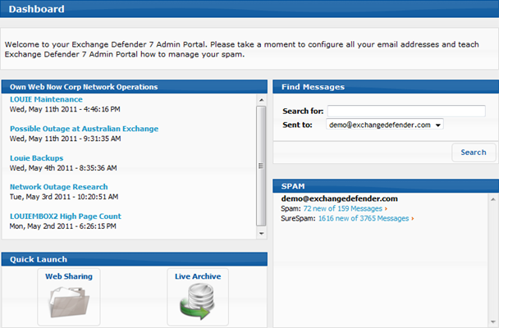
Dashboard Overview
ExchangeDefender dashboard is the home screen for all ExchangeDefender applications. Based on the AJAX technology, the web site responds and behaves more like a desktop application and provides smooth transitions and faster load times.
Across the top of the site you will see that navigation menu. You can access all of the sections of the ExchangeDefender service from here. On the left, you will see context navigation menus that will lead you to more advanced settings depending on what you are currently doing. Finally, the main section of the page takes up the majority of the web site and presents the most relevant data.
Dashboard page will offer your network operations alerts, quick launch links to other ExchangeDefender applications, Find Messages section for quick SPAM searches as well as your SPAM quarantine reports which reflect real-time SPAM contents of all your protected email addresses.

Slide 5
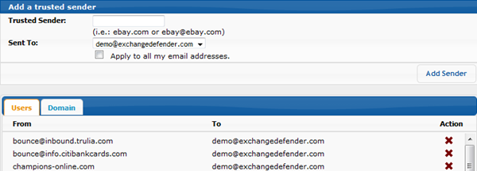
Managing Whitelists and Trusted Senders
ExchangeDefender allows you to manage your own whitelist of email senders that you never want screened for SPAM content. ExchangeDefender constantly learns from your usage patterns and adjusts the SPAM scores for your individual mailbox so this function should be used only when you are certain that you wish to trust this sender.
You can also see all of the domains that the organization trusts and always permits direct access to your Inbox.

