Slide 1

Hosted Exchange 2007

Slide 2


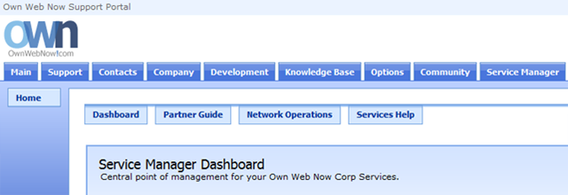
Introduction
The purpose of this Startup Guide is to familiarize you with ExchangeDefender's Exchange and SharePoint Hosting. ExchangeDefender provides enterprise grade Exchange 2007 and SharePoint hosting services that are redundant, reliable and protected by ExchangeDefender. With generous amount of storage and full flexibility of all Exchange and SharePoint features combined with the control panel that any client can use, ExchangeDefender delivers a powerful communication and collaboration platform.
Before you begin make sure you have met the following pre-requisites:
Does the client own their own domain? (Exchange hosting cannot be associated with third party email addresses such as @hotmail.com, @comcast.com, @gmail.com etc.)
Do you have the ability to manage the domain DNS settings and modify their MX record?
Ordering Mailboxes
1. Please login to the ExchangeDefender Support Portal (https://support.exchangedefender.com) with your email address and a password.
2. Click on the Service Manager tab. This will bring up the Service Manager Dashboard from which you can order and manage all your Exchange and SharePoint services.

Slide 3
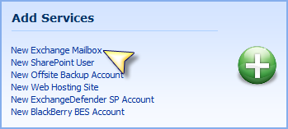
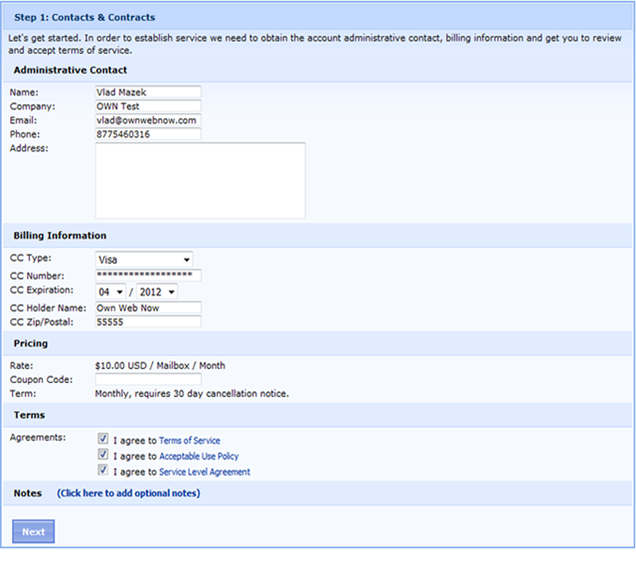
3. You can quickly subscribe to all of our services on the right in the Add Services section. Click on New Exchange 2007 mailbox to proceed.
4. Please provide the Contact and Billing information for this order. You will be asked to confirm your billing data, address and the usual contract terms of service agreements

Slide 4
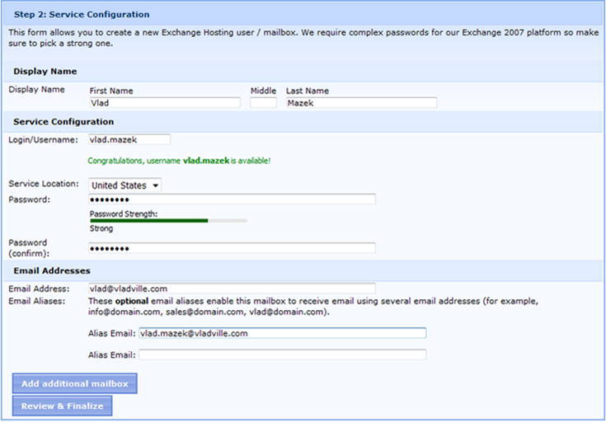
5. On Step 2: Service Configuration you will actually create your mailboxes. We have worked very hard to create a simple and streamlined process for creating a mailbox with as little information as possible. Just provide the users desired display name (first and last name required),login name (your choice), email address and password.
6. If you are only adding one mailbox please click on Review & Finalize. If you are ordering multiple mailboxes you don't have to go through the whole order process again, just click on Add Additional Mailbox. You will be prompted for mailbox configuration information and mailboxes will be added in a queue listed on the right. When done, click on Review & Finalize.

Slide 5
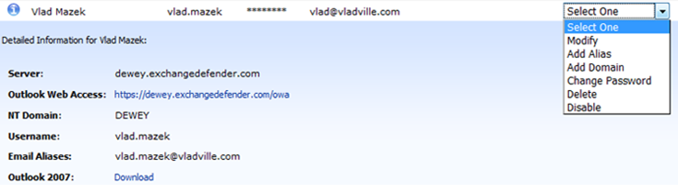
10. To the left of each mailbox is a blue "I" info button that displays detailed user information such as server name, domain name, login credentials and Outlook download link. To the right of each user is a management dropdown with Actions that can be performed on this mailbox. Each mailbox can be modified, have additional email aliases or alias domains added, passwords changed and the mailbox can be deleted right here. You also have an option to disable a mailbox if the client has not paid for the service or should not be allowed to login to their mailbox.
Note: If you Disable a user they will not be able to send or receive mail or access their mailbox in any way.

Slide 6
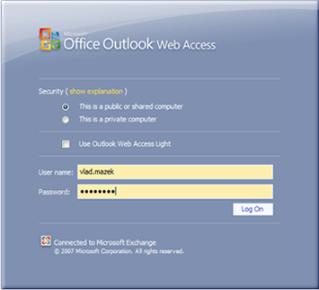
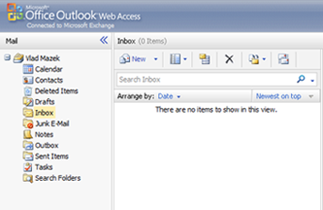
Logging into Outlook Web Access
1. To obtain the Microsoft Exchange Outlook Web Access URL for a mailbox, click on the icon next to the desired mailbox to display the Detailed Information section. Outlook Web Access address is available here. (See above).
2.Either click on the link or navigate to the URL using Microsoft Internet Explorer (Note: Using any browser other than Microsoft Internet Explorer will only give you the Outlook Web Access Lite which has less features and less flexibility than the full version).

Slide 7
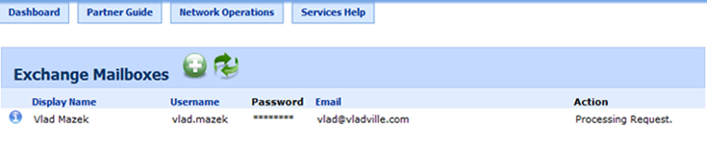


Setting Up Outlook 2007/2010
Exchange 2007/2010 has a lot of useful features that only work with Outlook 2007/2010, one of which is Auto Discover. Auto Discover allows Outlook to "self configure" itself using only the mailbox name, email address, password, and a autodiscover DNS record.
Before attempting to setup Outlook, log into your clients DNS control panel and create a CNAME record with the hostname "autodiscover" and as an example if your mailbox is on DEWEY the destination of autodiscover.dewey.exchangedefender.com
If you are not on DEWEY, you can substitute 'dewey' for your server, eg autodiscover.europe.exchangedefender.com .
1. Own Web Now Exchange 2007/2010 Hosting includes a Microsoft Outlook 2007/2010 license. You can download the media from the Service Manager in the mailbox details section.
2. If you already have Microsoft Outlook installed please confirm that it's closed and open your Microsoft Windows Control Panel.
3. Double click on the the Mail icon.
4. Click on Show Profiles. In order to minimize data loss we recommend creating an alternate (new) profile for your Own Web Now Exchange 2007/2010 mailbox.

Slide 8
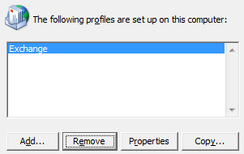
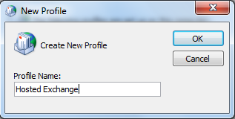
5. Click Add to create the new profile.
6. Name the new profile. For example, Hosted Exchange.

Slide 9
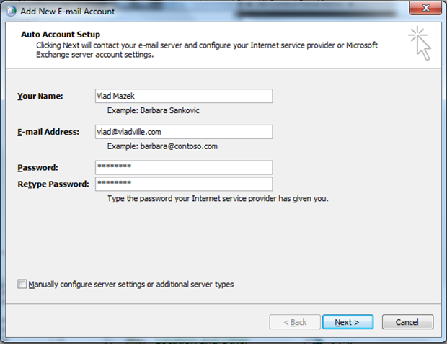
7. Type in the user's full name, email address, mailbox password and click Next. This will attempt to locate the autodiscover record created earlier.

Slide 10
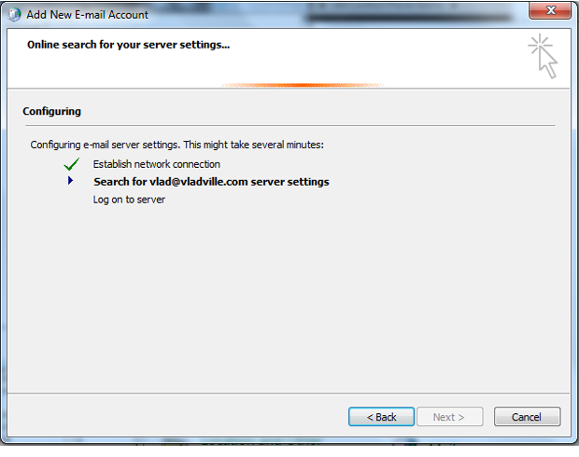
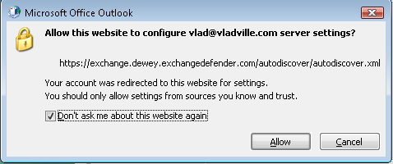
8. Outlook will begin to search for "autodiscover.clientdomain.com“.
9. Once Outlook connects to the Autodiscover IP, the client will warn that a referal is taking place. Select "Don't ask me about this website again" and select Allow.

Slide 11
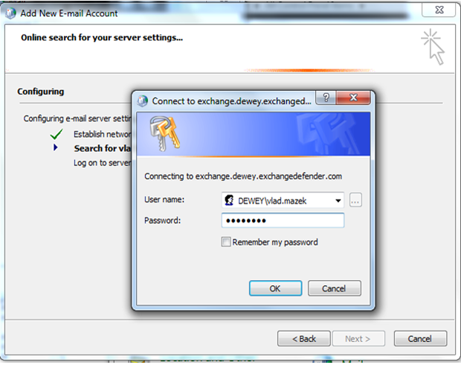
10. Outlook should prompt for user Authentication; Fill in DEWEY\Username for the username and the mailbox password.
Note: DEWEY is just used as an example. You should place the NT domain provided to you when you signed up for Exchange Hosting

Slide 12
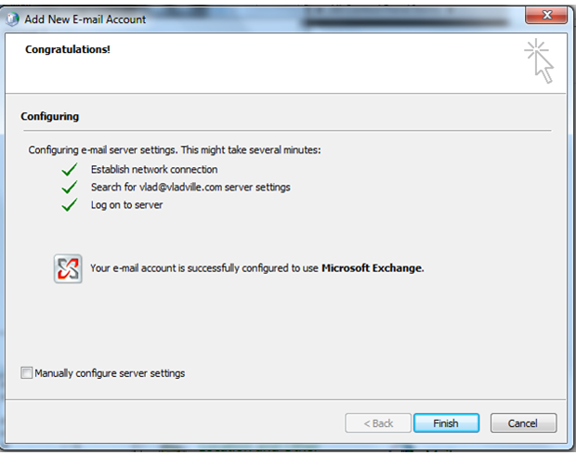
11. If everything was configured correctly, you should see a success message.
Congratulations, you can skip the below steps and begin "Migrating Mailbox Content"

Slide 13

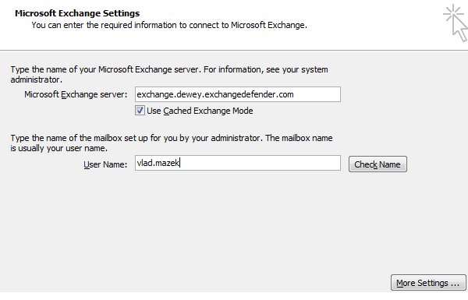
If you cannot use Autodiscover, you can follow the below steps to manually setup the Outlook Profile.
1. Check Manually configure server settings or additional server types.
2. Select Microsoft Exchange for the Email Service type.
3. Enter in the Exchange Server FQDN and username (Without the domain name) and select More Settings. Both are available from OWN Support Portal (https://support.exchangedefender.com) under the Service Manager tab, Exchange Hosting section.

Slide 14
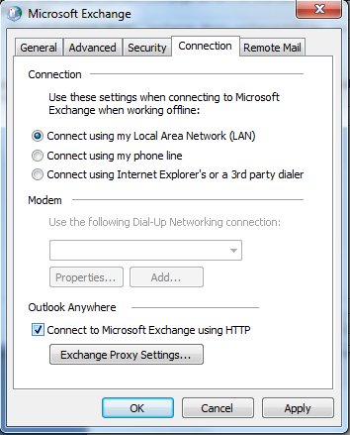
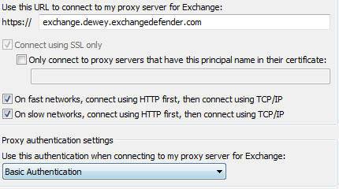
4. Navigate to the Connection tab and then select Connect to Microsoft Exchange using HTTP. Click Exchange Proxy Settings.
5. Enter in the Exchange server FQDN under the Proxy Server. Enable Connecting via HTTP first on fast and slow networks and set the authentication type to Basic. Submit the changes and click OK to finish adding the new profile. Note: Choosing to Connect using SSL only is enough, you do not need to specify any proxy servers.

Slide 15
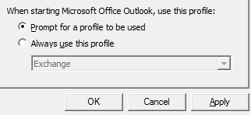
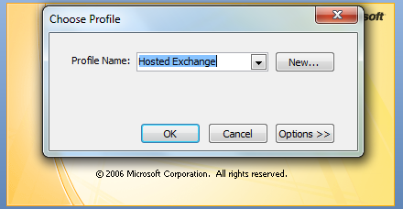
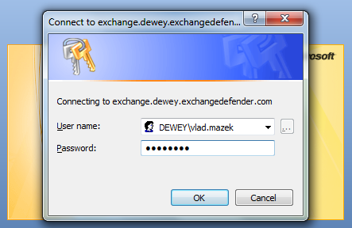
6. On the profile listing screen, ensure "Prompt for profile to be used" is selected.
7. Start Outlook 2007/2010 and select the newly created profile (Hosted Exchange).
8. When the password authentication box appears, set the username to "DOMAIN\username". Your domain and username information are available in the OWN Support Portal (https://support.exchangedefender.com) under the Service Manager tab, Exchange Hosting section.

Slide 16
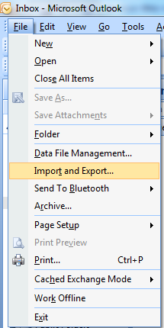
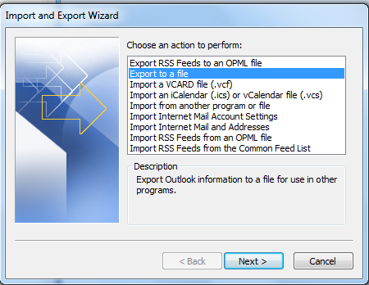
Migrating Mailbox Content
1. Start Outlook 2007/2010 and select the old user profile.
2. Select File, then Import and Export.
3. Select Export to a File.

Slide 17
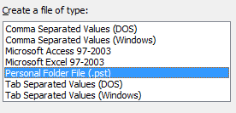
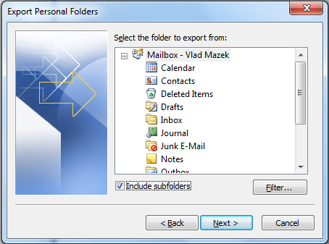
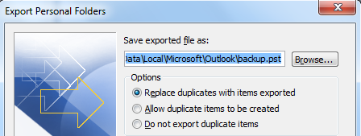
4. Select Personal Folder File for the type of file.
5. Select the mailbox for the export and select Include Subfolders. This will ensure we export all the contents of your mailbox including calendars, contacts and notes.
6. Select the export location and the duplicate options as illustrated below. Accepting the defaults is sufficient.

Slide 18
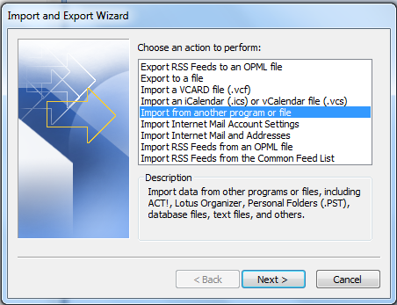
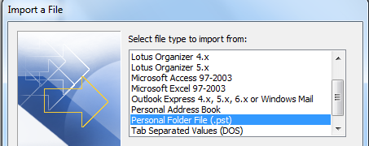
7.Once the export has completed (it may take a while) close Microsoft Outlook and start Microsoft Outlook with the new Hosted Exchange profile.
8. Select File, then Import and Export (Refer to Step 2 image).
9. Select Import from another program or file.
10. Select Personal Folder File (.pst) for the import file type.

Slide 19
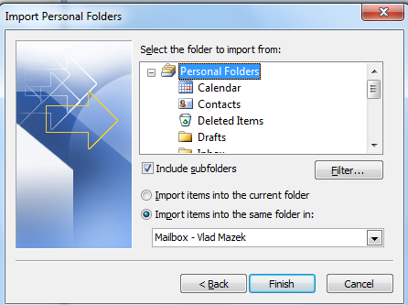
11. Choose the desired import options and select Finish.
Congratulations, you have successfully exported and imported your Microsoft Outlook mailbox and migrated to Own Web Now's Exchange 2007/2010 hosting. You can now delete the old profile if you have created a full backup and do not believe you will ever have to access it.

