Slide 1
ExchangeDefender
Deployment Guide
For the latest version of this document please go to: http://www.exchangedefender.com/documentation.php

Slide 2


ExchangeDefender Introduction
The purpose of this guide is to familiarize you with ExchangeDefender and walk you through the configuration, management and deployment of the service. ExchangeDefender is a transparent, cloud-based security solution that protects users from email SPAM, viruses and even dangerous content on the web. In addition to the security, ExchangeDefender also includes LiveArchive, a business continuity solution as well as a long term archiving solution for HIPAA / SOX / SEC compliance and eDiscovery. Furthermore, ExchangeDefender also has transparent SMTP encryption, web file sharing, desktop tools and more to protect all corporate communication and collaboration activities on the Internet.
You can find more information about the service at http://www.exchangedefender.com.

Slide 3
Checklist
In order to deploy ExchangeDefender and safely secure the mail server and individual users you need to have access to the following:
Domain Name (DNS) control - Because ExchangeDefender SMTP Security is activated by pointing the domain's mail exchanger (MX) record to inbound30.exchangedefender.com you must have the ability to change the DNS.
Mail Server Administrative access - Hackers and spammers can bypass ExchangeDefender if the mail server remains exposed to anonymous SMTP traffic. Furthermore, some data such as Active Directory (LDAP) access can only be accessed from the mail server. Finally, you will have to disable some built in antispam software that will interfere with the delivery of SPAM reports.
Firewall access - You will need to make certain changes to the network access, such as blocking anonymous SMTP connections from the Internet unless they come from the ExchangeDefender IP ranges, and blocking internal SMTP connections to the external servers in case your network is compromised.
Desktop (Administrative User) access - If you wish to deploy ExchangeDefender Outlook Addin, ExchangeDefender Desktop Agent or ExchangeDefender Web Security agents, you will need to have administrative access to the desktop in order to install software on the local system. We also recommend creation of several shortcuts on the users' Desktop so they can quickly locate ExchangeDefender resources when they need them.
Network Configuration - You will need to know the IP address that the clients mail server is currently using and you must be able to accept mail on port 25 (while ExchangeDefender can deliver mail to ports other than 25, advanced configurations are beyond the scope of this guide).
Business Requirements - You will need to make business related decisions about which features of ExchangeDefender will be enabled or disabled, when you would like to receive daily or intraday SPAM reports, whether or not you wish to enable LiveArchive business continuity, which passwords to assign to the new users and the contact information for the IT or contact person in the organization.

Slide 4
Service Provisioning
ExchangeDefender Service enrollment is a four step process through which you will be adding and configuring a new domain and it's users to the service. In the first step, you will be choosing how you wish to provide the user lists to ExchangeDefender. In the second step, you will be approving the domains that are about to be protected by ExchangeDefender. In the third step you will be reviewing email addresses and display names. Finally, you will be providing the service configuration and site specific policies for the new organization.
Creating Users: How to pick the right method
ExchangeDefender offers three ways to create user accounts and import email addresses that will be protected by ExchangeDefender. Please review the following information carefully before selecting one.
XML Import - This method is recommended for smaller sites running Microsoft Exchange mail servers. If you choose this method you will be downloading a Visual Basic Script (.vbs) that will export Active Directory mail-enabled user objects in an XML file that you can upload to ExchangeDefender. All users and associated display names and email addresses will be imported.
Manual Configuration - This method is recommended for smaller sites and servers that are not running Microsoft Exchange and do not have an LDAP directory. Manual Configuration allows you to use a wizard import tool to type in users names and email addresses directly into ExchangeDefender.
XDSYNC LDAP tool for ExchangeDefender - This method is recommended for larger deployments of Microsoft Exchange, or environments with high user turnover. By installing XDSYNC LDAP tool on your Microsoft Exchange server you will be assured that all changes to your mail-enabled Active Directory users will be applied to ExchangeDefender, removing any maintenance and user management of ExchangeDefender or double data entry.

Slide 5
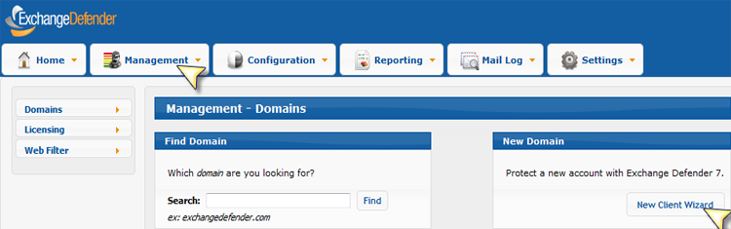
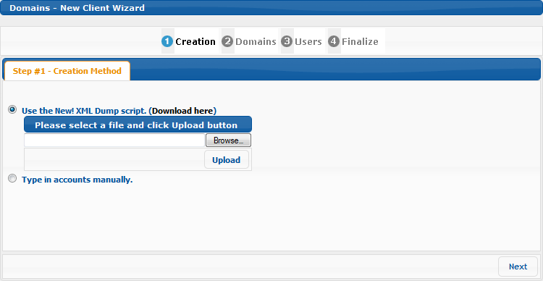
Service Enrollment
Protecting a domain with ExchangeDefender is quick and simple. First, let's get the list of users to add to ExchangeDefender.
1. To start the process please login as the Service Provider at https://admin.exchangedefender.com. Click on the Management tab and then on the New User Wizard:
2. Select how you wish to create your users:

Slide 6
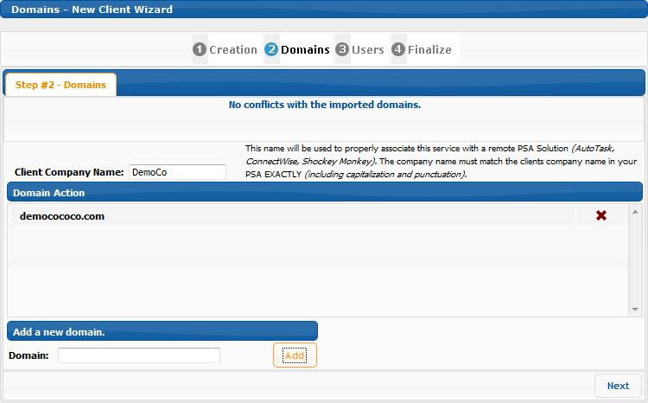
If you wish to type in the accounts manually, or if you wish to use the XDSYNC LDAP tool for ExchangeDefender, select "Type in accounts manually." And skip to step #4.
If you wish to use the XML Dump script, which we recommend, please download the script from the screen above and proceed to step #3.
3. If you have chosen to use the XML Dump script (Visual Basic) please download it to your Microsoft Exchange server and execute it at the command prompt as follows:
cscript ExportAddresses.vbs
This script will create an XML file that you will have to upload to the screen above. The file is C:\EmailAddresses.xml
Click on Upload and when the file is confirmed, click on Next. Proceed to step #4.
4. In this step you will be asked to provide the domain names that will be protected on this server. You must type in the domain names and click on Add to validate the domains. If you import an XML file, the system will already list the domain names it has identified in the XML file. If there are any problems with the domains (such as invalid domain or a domain that is already protected by ExchangeDefender) they will show in the"Conflict" section at the top.

Slide 7
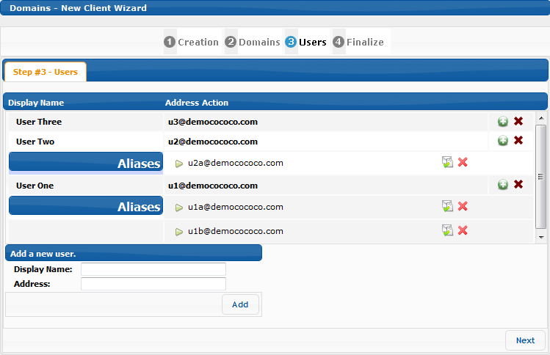
5. In this step we will confirm that our users are listed correctly.
You can add users to this list manually by typing in the users name and email address in the form on the bottom and clicking Add. Each user and alias will show up and you can add, remove or delete aliases or users from this list in realtime.
Note: If you are using XDSYNC LDAP tool, you should only add the Administrator account here. The rest of the users will be uploaded automatically by XDSYNC.

Slide 8
6. Finally, let's configure the domain policies.
Users Password - Please select the default password that will be assigned to the accounts you are about to create. Users can change this password at any time.
Administrator - Administrator is typically the IT contact person at the organization and the users on whose behalf all welcome messages are sent to the users. Note: The password assigned here is the domain password that the site administrator can use to login to admin.exchangedefender.com and manage all the user and domain configurations.
Inbound IP Address - This is the IP address to which we will deliver all inbound mail. If you have a complex inbound network and wish to load balance the delivery across multiple servers or create a failover scenario, click on Advanced Settings.
Outbound IP Address - This is the IP address from which we will accept outbound mail. If you have more than one IP address please provide it under Advanced Settings. Note: Typically the inbound and outbound IP address are the same.
SPAM Action - What should we do with SPAM messages? We recommend to quarantine them.
SureSPAM Action - What should we do with SureSPAM messages? We recommend to delete them.
SPAM Life - How long should we keep the SPAM messages in the quarantine? By default we only keep 7 days meaning the user can release any quarantined SPAM messages received over the past seven days. Around holidays it makes sense to extend this period if staff takes longer vacations. Note: We do not recommend changing this interval. Doing so causes exponential performance degradation because the database is larger and queries run exponentially slower.
Report Options - Choose if you want to enable Daily or Intraday SPAM digest reports. We recommend disabling these reports and relying on the portal, Outlook Addin or Desktop agent.
Report Schedule - If you have enabled the SPAM digest reports, pick the time at which you would like to have them generated. It takes up to 30 minutes for the report to be generated so please keep in mind that this setting only controls when the report is scheduled to be processed, not when it will be delivered.
Report Contents - Report Contents allow users that have a lot of email addresses to not report email addresses that have no SPAM in the quarantine. Enabling this removes pages of "No SPAM Quarantined" in the report and reduces the report size.
Time Zone - Time zone in which the clients server is located.
LiveArchive - Select to enable or disable LiveArchive Business Continuity. If you choose to enable this solution, each user must login to their account when the domain is created in order to initialize the mailbox.

Slide 9
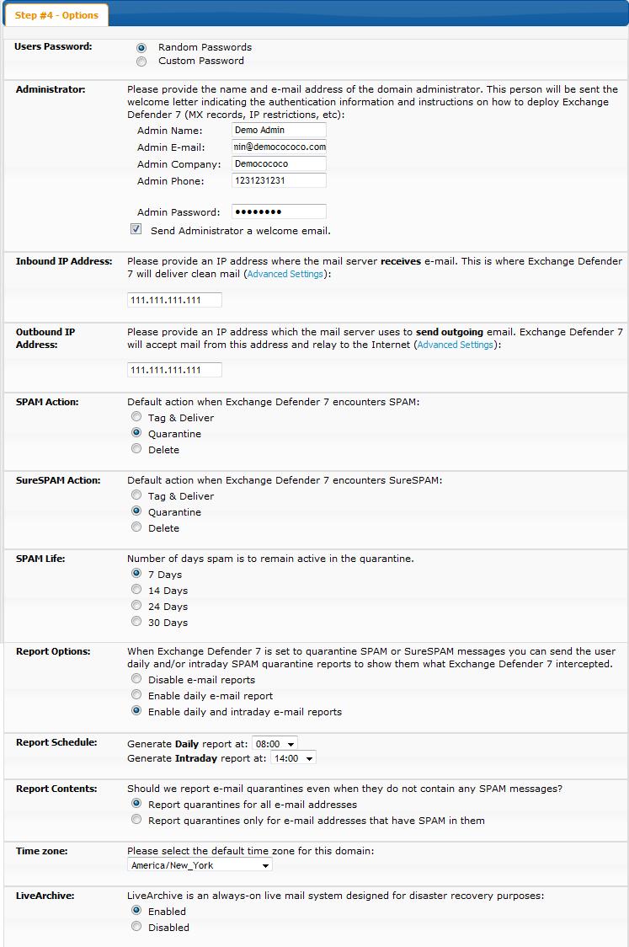

Slide 10
7. Congratulations, you have enabled ExchangeDefender SMTP Security protection on your domain. Please allow for up to an hour for the new configuration to propagate to all of ExchangeDefender servers and proceed to the next section on configuring your infrastructure. If you've chosen to create users using XDSYNC LDAP tool for ExchangeDefender, please refer to this document now.

Slide 11
Network Configuration
In order to properly deploy ExchangeDefender, you need to make several changes on your network. First, you have to change your MX record to point all of your inbound mail to ExchangeDefender. This way ExchangeDefender will stand in front of your mail server and bounce all the dangerous content that is sent to your network. Then, you should change your outbound smarthost to allow us to scan all of your outbound mail*. Finally, enforce IP restrictions so that you can only exchange mail through a trusted connection with ExchangeDefender.
*For users that rely on email for correspondence, outbound network will automatically archive all outbound emails. If you have a business requirement that includes sending out notifications, automated responses, marketing, large distribution lists or other non-correspondence items, we offer outbound-jr high speed relay designed for that specific need.
MX Record
Please modify your MX record and change it to: inbound30.exchangedefender.com
You should not have any other MX records for your domain name (subdomain MX records are OK).

Slide 12
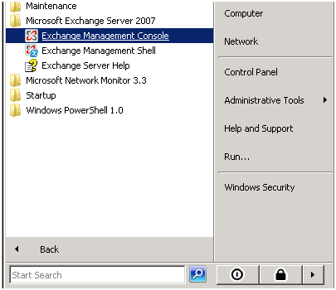
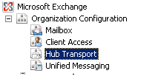
Outbound Smarthost
Please modify your SMTP server to route all outbound mail through the following smarthost: outbound.exchangedefender.com
Please follow these instructions to modify the smarthost on Exchange 2003 and 2007:
Exchange 2007/2010
1. Login as the Administrative user to your Exchange 2007/2010 server and open Exchange Management Console.
2. Expand Organizational Configuration, click Hub Transport.

Slide 13
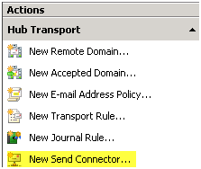
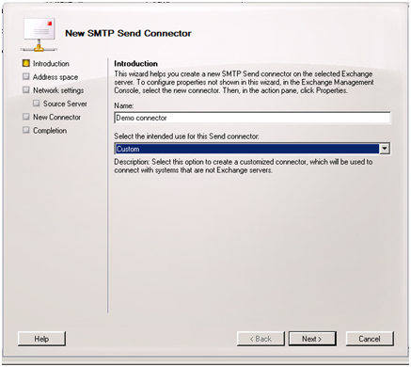
3. On the right hand side under Actions click New Send Connector.
4. Give the Send Connector a name and select the intended use as Custom.
5. Click the Add button on the Address Space screen.

Slide 14
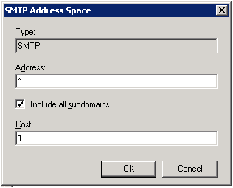
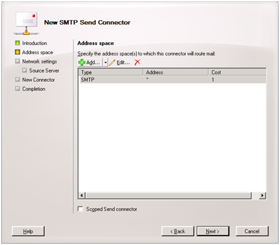
6. Under Address put the recipient domain name, check include all sub-domains and leave the cost as low as possible, click OK.
7. Click Next.

Slide 15
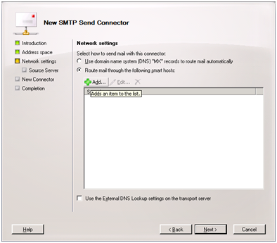
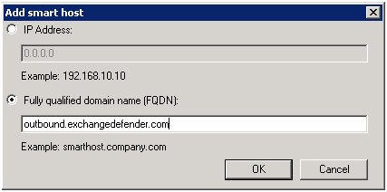
8. Select the radio button to "Route mail through the follow smart hosts:" and click Add.
9. Select the radio button to "Fully qualified domain name (FQDN):" and enter "outbound.exchangedefender.com" and click OK.

Slide 16
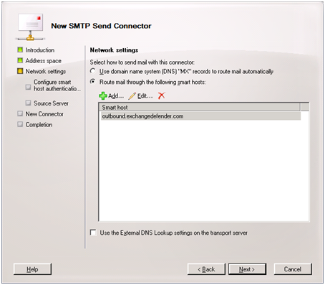
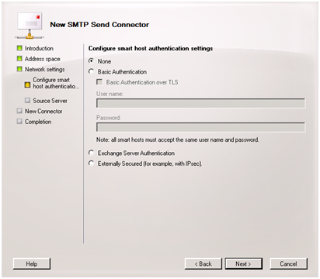
10. At this point, you should be able to see the server you specified listed then click Next.
11. Since ExchangeDefender uses your server's IP Address to authenticate access, leave the radio button set to Authentication Settings "None" and click Next.

Slide 17
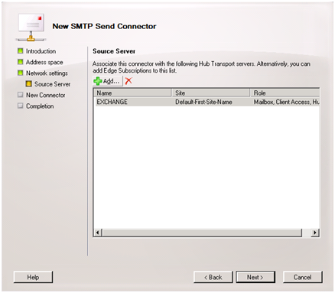
12. On the source server screen verify that the exchange server is listed (If not, click Add and find the server) and then click Next.
13. On the final screen you will see the commands that will be run to create the send connector. Click New and on then Finish.

Slide 18
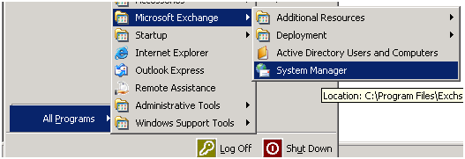
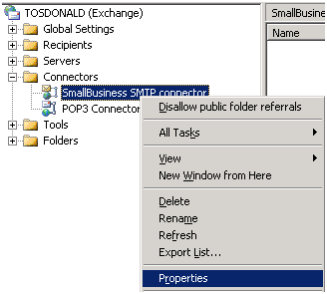
Exchange 2003
1. Login to your Exchange 2003 server and open System Manager.
2. Expand Connectors , right click Small Business SMTP Connector (or your active outgoing SMTP connector) and select properties.

Slide 19
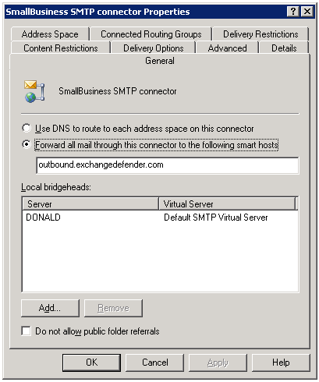
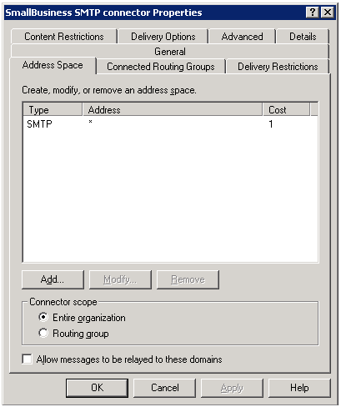
3. In the general tab, set the radio option to Forward all mail through this connector to the following smart hosts and inputoutbound.exchangedefender.com
4. Navigate to the Address Space tab and ensure there is one entry with the address specified as * and the Cost as 1.

Slide 20
IP Restrictions
Enforcing IP restrictions is absolutely critical to complete protection of your mail server. Because hackers and spammers can easily bypass cloud services and target your server directly, mail servers protected by ExchangeDefender should accept anonymous SMTP connections only from the ExchangeDefender networks listed below:
65.99.255.0/24
206.125.40.0/24
You should allow inbound SMTP traffic from the above IP ranges only and deny all other traffic. You should only allow outbound SMTP traffic from your mail server to the ExchangeDefender outbound servers.
Please follow these instructions to enforce IP restrictions on Exchange 2003 and 2007:
Exchange 2007/2010
To program the IP address restrictions on the receive connector in Exchange 2007:
1. Obtain the latest list of ExchangeDefender IPs from the ExchangeDefender Deployment Guide under 'Configuring IP Restrictions‘
2. Open Exchange Management Console

Slide 21
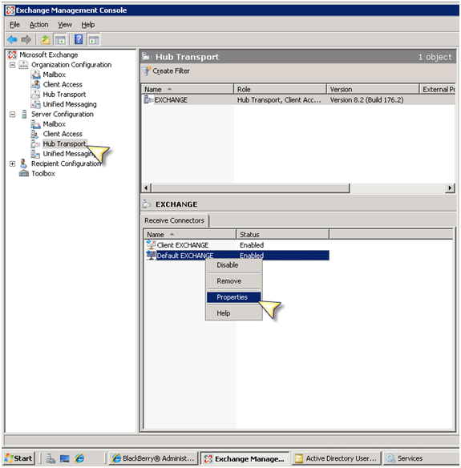
4. SBS Users: Right click on the "SBS Internet Mail Connector" and select Properties
NON-SBS Users: Right click on "Default SERVERNAME" and select "Properties".

Slide 22
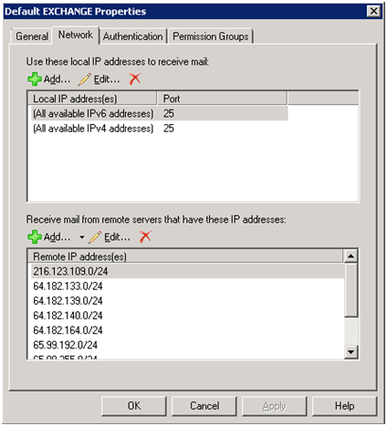
5. Once the dialog box pops up select the "Network" tab:
6. Under "Receive mail from remote servers that have these addresses:" find the entry that says 0.0.0.0-255.255.255.0 and delete the record.

Slide 23
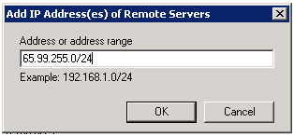
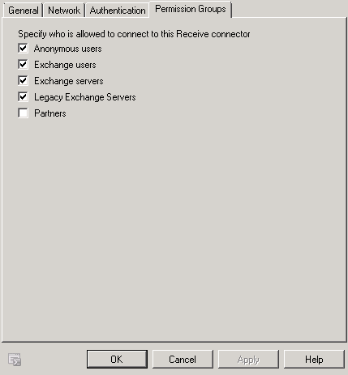
7. Under "Receive mail from remote servers that have these addresses:" click Add. Input the first ExchangeDefender IP range/netmask. Repeat this step for each ExchangeDefender IP network in the deployment guide.
8.Please ensure under the Authentication tab that Anonymous delivery is allowed from our ranges.

Slide 24
Exchange 2003
1. Obtain the latest list of ExchangeDefender IPs from the ExchangeDefender Deployment Guide under 'Configuring IP Restrictions‘.
2. Login to your Exchange 2003 server and open System Manager.

Slide 25
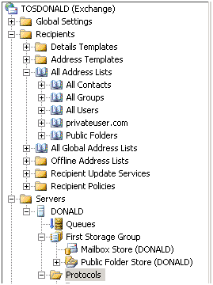
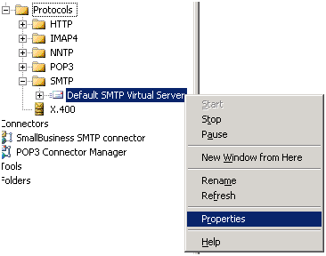
3. Expand Servers, ServerName, Protocols, SMTP - right click "Default SMTP Virtual Server" (Or the active receive connector name) and select properties.

Slide 26
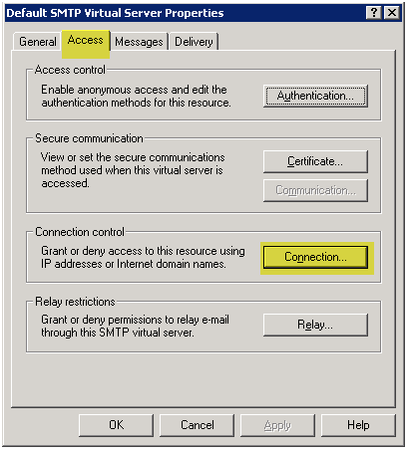
4. Navigate to the Access tab and then select the Connection button.
5. Remove any entries from previous providers or entries that have the IP range 0.0.0.0 - 255.255.255.0

Slide 27
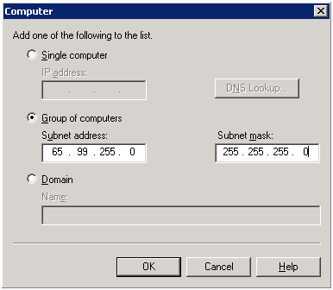
6. Click Add to enter a new IP restriction. Select the Group of computers option, insert the first IP range for ExchangeDefender and set the subnet mask to 255.255.255.0 - click OK. Repeat this step for each ExchangeDefender network.
7. Restart the Simple Mail Transfer Protocol (SMTP) service to apply the changes.
Warning: Do not enforce IP restrictions until at least 72 hours after the MX record change. Enforcing IP restrictions while your old DNS zone is still cached on the Internet will result in a permanent mail loss and mail delays.
Should the IP restrictions be applied on the firewall or on the mail server? We are frequently asked this question and the answer depends on whether you have external users or third parties attempting to relay mail through your mail server. If you have external connections to your SMTP server (from third party vendors or mobile users) then it is easier to enforce restrictions on the mail server and enforce password protected SMTP access there. However, if you do not have external connections the restrictions should be enforced on the firewall in order to free up resources on the mail server.

Slide 28
Network Configuration
Own Web Now Corp recommends deployment of Client Software Suite solutions over email Daily and Intraday digest reports for several reasons:
Over 99% of all email SPAM reports are ignored or filtered to junk mail.
Outlook and Desktop addins allow for real-time access to SPAM quarantines and settings.
Client Desktop solutions work the way users do, in the applications they use.
Client Desktop solutions are interruptive, they alert the users when necessary.
ExchangeDefender Client Software Suite was designed to give the user a more familiar experience, closely tied to the way they access their email and messaging. Outlook 2007 addin is perfect for Outlook power-users that never want to leave their Outlook experience. Similarly, Windows Desktop agent "annoyerizer" was designed for sales professionals, travel agents, financial industry employees and anyone that needs frequent alerts telling them that SPAM has been blocked from their inbox.
For more information about Client Software Suite please see the following page:
http://www.exchangedefender.com/features_client_software.php.
Documentation, branding and deployment instructions are available in the individual downloads.
Advanced Deployment Considerations
ExchangeDefender is a very flexible security solution and we encourage our more technically advanced partners to use ExchangeDefender to improve reliability and failover of their own sites with ExchangeDefender's help.

