Slide 1

BlackBerry Enterprise Server

Slide 2


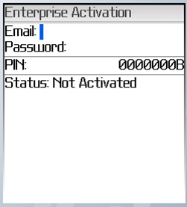
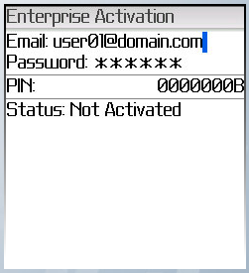
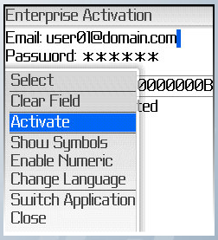
Legacy BlackBerry Activation Process
1. Please be sure to be on the Enterprise Activation screen. Depending on the device it can be found in the Options or Advanced Options.
2. Type the email address and enterprise activation provided in your order request. Make sure you type this information accurately because a mistake may cause the activation process to fail.
3. Once you have typed the email address and activation password, open the menu and click Activate.

Slide 3
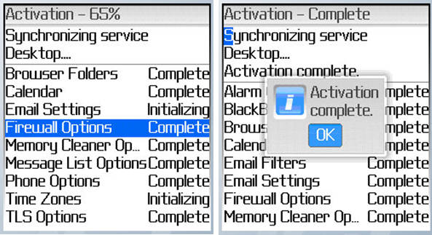
4. At this point, the rest of the process should no longer require user input but we will outline the sequence of screens through the rest of the activation process.
5. After the email connection has been made and confirmed the actual synchronization process begins and completes as seen below:
Congratulations, your BlackBerry device is now synchronized and activated!

