Slide 1

BlackBerry Enterprise Server 6.0

Slide 2


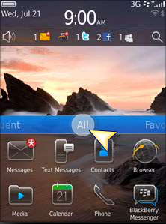
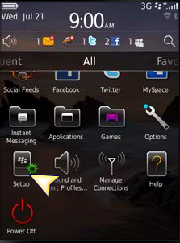
BlackBerry 6.0 Activation Process
1. Select the All Button on the Home screen.
2. Find and select the Setup icon.

Slide 3
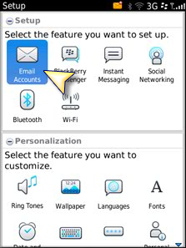
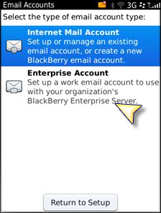
3. Select Email Accounts.
4. Select Enterprise Account.
Note: An alternate route on some devices is Options > Device > Advanced System Settings > Enterprise Activation.

Slide 4
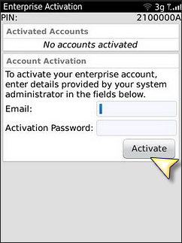
5. Input the email address and password selected for BES Activation NOT your email password).
6. Once you click on Activate, the phone will begin the lengthy (varying on your connection and mailbox size) activation process. Remember that if you have poor to average data signal you can expect a longer activation period.
Note: Please do not cancel activation attempts unless advised to do so by someone in Support. Passwords are good by default for 48 hours or 5 attempts.

